Slide 1
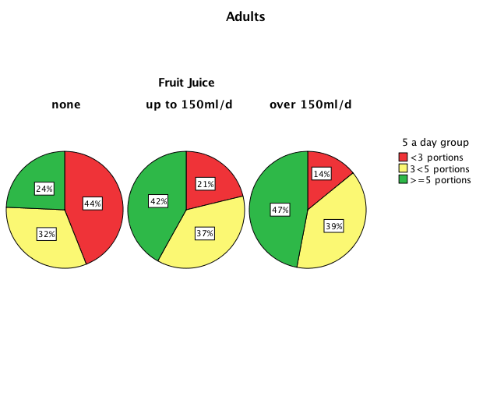
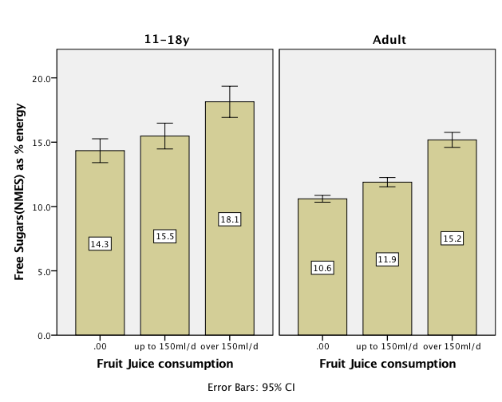
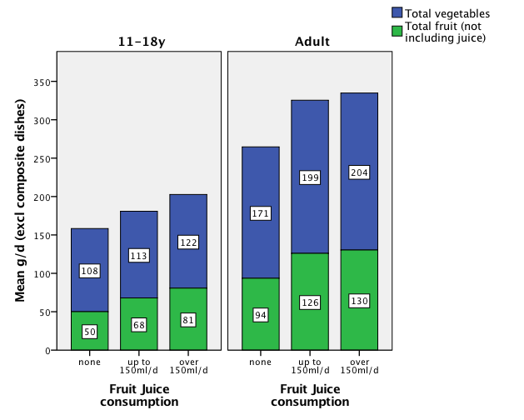
Fruit juice consumption is associated with intakes of whole fruit and vegetables, as well as non-milk extrinsic sugars: a secondary analysis of the National Diet and Nutrition Survey (NDNS)
S. Gibson, Registered Nutritionist, SiG-Nurture Ltd, 11 Woodway, Guildford GU1 2TF
C.H.S. Ruxton, Freelance Dietitian, Nutrition Communications, Cupar KY15 4HQ
Are concerns about fruit juice valid?
In the drive to lower the population mean to <5% daily energy from free sugars, there has been a negative focus on the role of fruit juices (FJ) in the British diet. FJ provides 8-12% of daily non-milk extrinsic sugars (NMES) depending on age.
3. FJ and support of 5-A-day
61% of teens and 34% of adults had fewer than 3 portions of F&V each day
FJ contributed 0.3 portions F&V overall
FJ adult consumers were more likely to consume 5-A-day (39%) than non-consumers of FJ (23%) and were less likely to consume <3 portions F&V (P<0.001).
Similar pattern found in teens.
Methods
We examined associations between FJ intake and other dietary parameters in a secondary analysis of the NDNS 2008-12 (n=2967; 11-99 year olds):
Do we drink too much FJ?
Does FJ consumption displace fruit and vegetables (F&V)?
Does FJ consumption support 5-A-day?
How does FJ consumption impact on NMES intakes?
1. Do we drink too much FJ?
Mean FJ consumption was 83g/d (11-18 year olds) and 52g/d (19-64 year olds), mostly as orange juice
This is below the 150ml portion cited as counting as one of your 5-A-day (Eatwell)
Only 25% of people drank FJ in the 4d survey period (39% teens, 22% adults).
4. NMES intake
Higher FJ intake was significantly associated with higher NMES in adults
In teens, NMES intakes were only significantly higher when FJ intakes > 150ml/d
Non-consumers of FJ nevertheless exceeded the free sugar recommendation of 5% energy.
2. Displacement?
Whole F&V consumption rose with FJ intake so FJ did not appear to displace whole F&V.
Linear trend P<0.001
Conclusion
Consuming up to 150ml/d FJ offers a benefit in terms of 5-A-day compliance and has no impact on NMES intakes in teenagers.
This work was funded by the British Fruit Juice Association www.bfja.org

