Slide 1


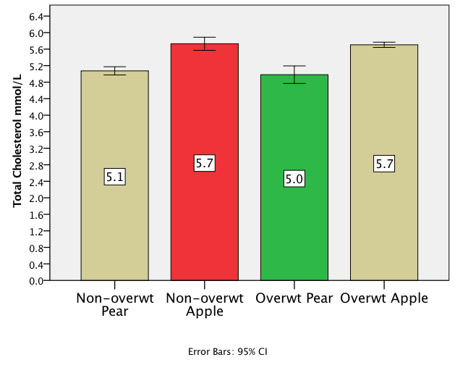
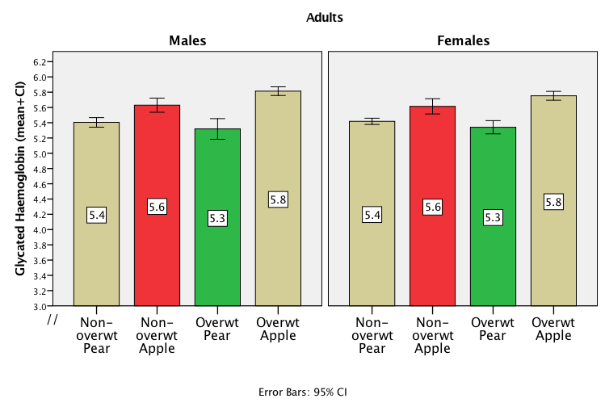

Non-overweight ‘apples’ have higher levels of cardiometabolic risk factors than overweight ‘pears’: waist-to-height ratio is a better screening tool than BMI for blood levels of cholesterol and glycated haemoglobin
Sigrid Gibson ª and Margaret Ashwell ^{b}
ª Sig-Nurture Ltd, Surrey, UK, GU1 2TF and ^{b} Ashwell Associates, Ashwell, Herts., UK, SG7 5PZ.
Contact: sigrid@sig-nurture.com
Introduction and Aim
We have previously shown that using BMI as a sole proxy for obesity, and ignoring measures of central obesity such as waist to height ratio (WHtR), would misclassify around 10% of the whole UK population, and more than 25% of those of normal weight, as “not at risk’’¹
We explored the implications of this ‘misclassification’ in screening for the cardiometabolic risk factors, total cholesterol (TC) and glycated haemoglobin (HbA1c) using data from the Health Survey for England 2009 (HSE).
There were 2917 adults aged 16y and over.
Methods
The HSE population was classified into four groups (2x2) using standard boundary values of BMI (<>25kg/m²) and WHtR (<>0.5)
Fig 1 Prevalence of high WHtR (0.5) according to BMI status
Results
34% of adults (41% of men and 29% of women) classified as ‘non-overweight’ by BMI, have WHtR exceeding 0.5 ( Fig 1)
Overall, 12% of the total population would be missed by BMI screening - the non-overweight ‘apples’ (346/2917).
Fig 2 Total cholesterol (mmol/L) according to classification by BMI and WHtR
The group with low/normal BMI but high WHtR (non-overweight ‘apples’) had significantly higher mean TC than the group with high BMI but low WHtR (overweight ‘pears’) (5.73mmol/L; SE 0.08 vs. 4.98mmol/L; SE 0.11; P<0.0001)
(Fig 2).
Similarly, HbA1c levels were higher among non-overweight ‘apples’ than among overweight ‘pears’ (5.62% SE 0.03 vs 5.33% SE 0.04; P<0.0001)
These differences were also significant in both sexes
(Fig 3).
Fig 3. HbA1c (%) according to classification by BMI and WHtR for men and women
Conclusions:
This study not only supports our previous findings on the superiority of WHtR over BMI as a primary screening method for morbidity² and mortality³ risk, but it also demonstrates the potentially severe implications of misclassification by BMI alone in screening for cardiometabolic risk factors.
1.Ashwell M, Gibson S. A proposal for a primary screening tool: 'Keep your waist circumference to less than half your height'.
BMC Med. 2014;12:207.
2.Ashwell M, Gunn P, Gibson S. Waist-to-height ratio is a better screening tool than waist circumference and BMI for adult cardiometabolic risk factors: systematic review and meta-analysis. Obes Rev. 2012;13(3):275-286.
3.Ashwell M, Mayhew L, Richardson J, Rickayzen B. Waist-to-height ratio is more predictive of years of life lost than body mass index. PLoS One. 2014;9(9):e103483
Sig-Nurture Ltd.
Nutrition Research Consultants
Notes:
Waist-to-height ratio is more accurate than body mass index to quantify reduced life expectancy
Introduction: Our aim was to compare the effect of central obesity ( measured by waist-to-height ratio-WHtR) and total obesity ( measured by body mass index-BMI) on life expectancy expressed as years of life lost (YLL), using data on British adults.
Methods: A Cox proportional hazards model was applied to data from the prospective Health and Lifestyle Survey (HALS) and the cross sectional Health Survey for England (HSE). The number of years of life lost (YLL) at three ages( 30, 50, 70 years) was found by comparing the life expectancies of obese lives with those lives at optimum levels of BMI and WHtR.
Results: Mortality risk associated with BMI in the British HALS survey was similar to that found in US studies. However, WHtR was a more sensitive indicator of mortality risk. For the first time, data have been produced to quantify YLL at different values of WHtR for both sexes separately and for three representative ages.
Conclusion: This study supports the simple message "Keep your waist circumference to less than half your height"[1]. The use of WHtR in public health screening, with appropriate action, could help add years to life.
Conflict of interest: MA devised and copyrighted the Ashwell ® Shape Chart; distributed on a non-profit making basis.
Funding for this research (partial) was provided by the Actuarial Profession.
1. Ashwell M, Gunn P, Gibson S: Waist-to-height ratio is a better screening tool than waist circumference and BMI for adult cardiometabolic risk factors: systematic review and meta-analysis. Obes Rev 2012;13:275-286.
Fit of proportional hazards models
The Cox proportional hazards model took the form:
where
=hazard (force of mortality) of i^{th} individual at time t,
=baseline hazard at time t
x_{ni} are covariates
b_{n} are covariate coefficients

